Slide 1
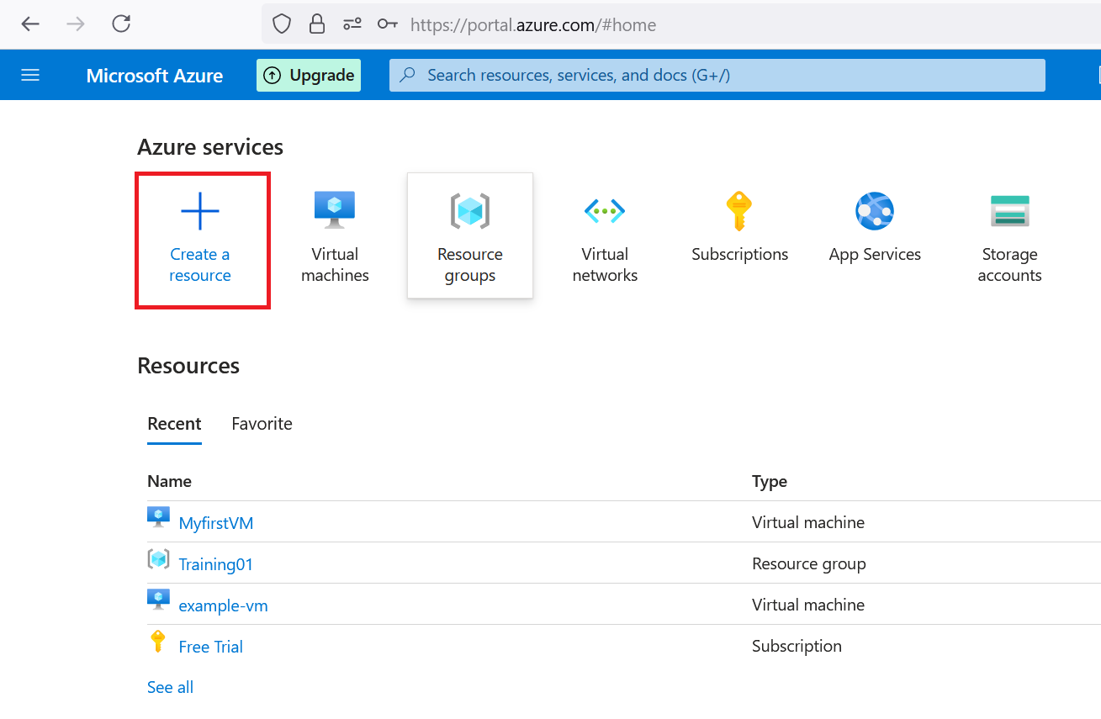
Please use create a resource utility

Slide 2
Creating resource by Console
Here, you would be using GUI to create the resource.
Drawback: No tracking mechanism.

Slide 3
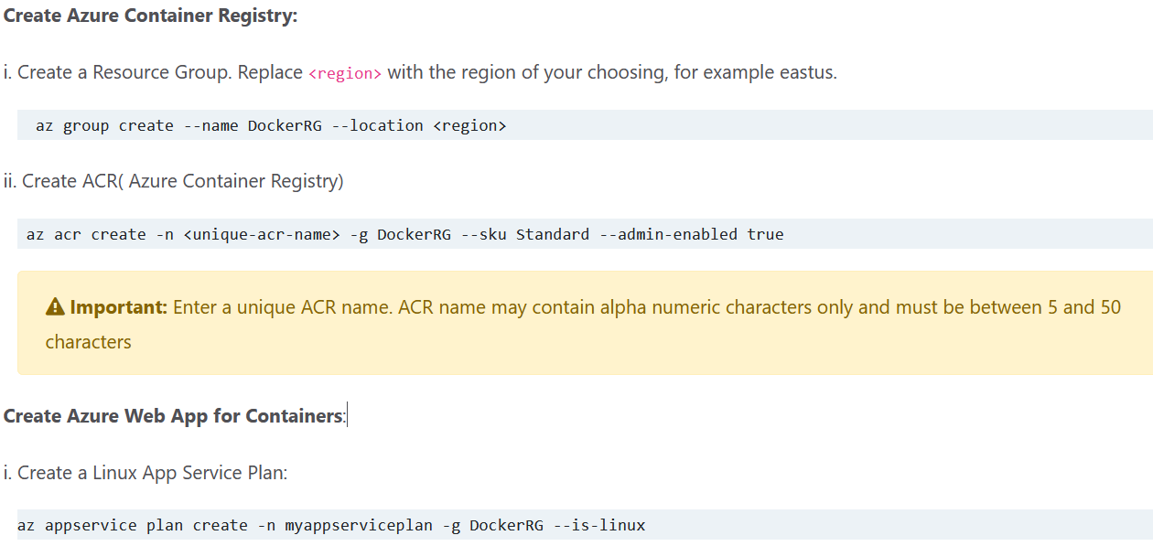
CLI > Mostly not recommended, but better then Manually

Slide 4
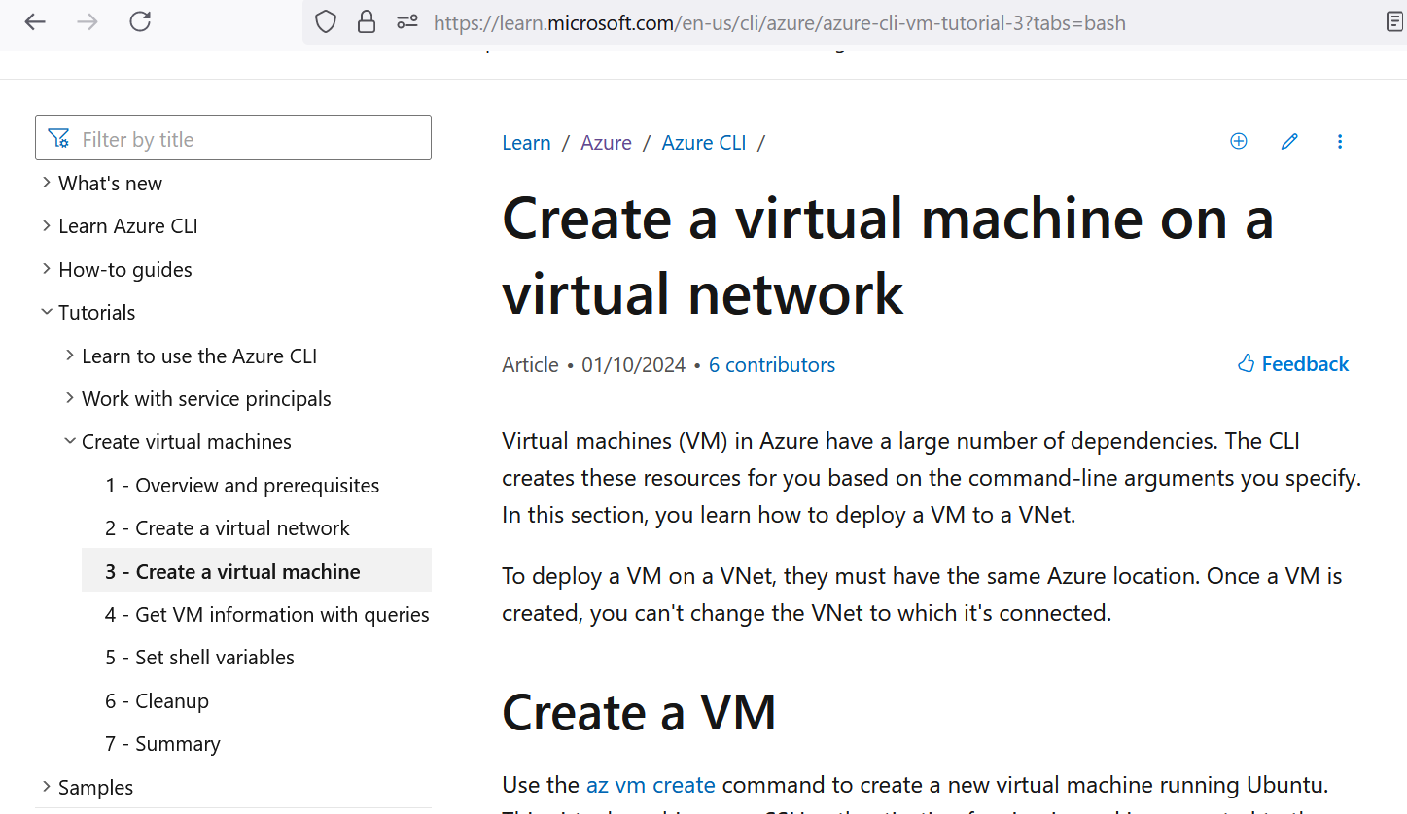

Slide 5
Creating VM by Azure CLI
Link: https://learn.microsoft.com/en-us/cli/azure/azure-cli-vm-tutorial-3?tabs=bash

Slide 6
By Terraform
Very effective Easy to learn
Migration is Easy
Very good documentation

Slide 7
ARM Template
Link: https://learn.microsoft.com/en-us/azure/azure-resource-manager/templates/overview
How to deploy ARM Template
https://learn.microsoft.com/en-us/azure/azure-resource-manager/templates/template-tutorial-create-first-template?tabs=azure-cli
How to create ARM template> by Visual studio code

Slide 8
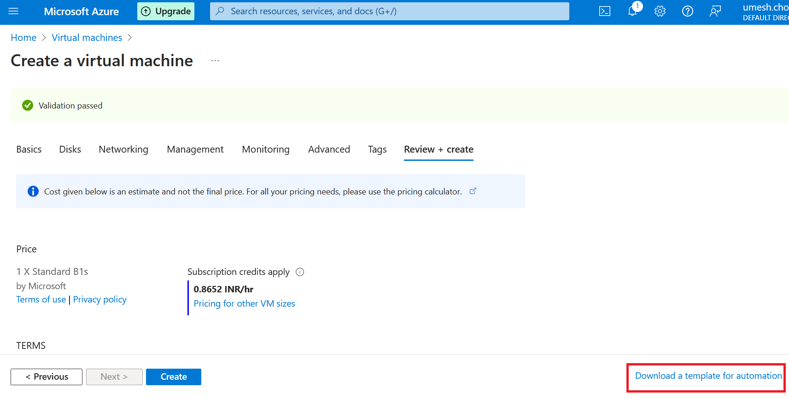

Slide 9
